Slide 1
AtliQ Hospitality Management Using Power bi
Power BI Project
Data Analytics Dashboard
Dharmindar Ram Linkedin Portfolio Github E-mail

Slide 2
Key Skills practised:
AtliQ Hospitality Management Using Power BI
Power BI
Data Modelling
Data Transformation
DAX
Data Visualizations
Business Insights
Dharmindar Ram Linkedin Portfolio Github E-mail

Slide 3
Project Purpose:
AtliQ Hospitality Management Using Power BI
The main aim of this project is to understand the hospitality domain, analyze data and create a dashboard for stakeholders to manage their business.
Dharmindar Ram Linkedin Portfolio Github E-mail

Slide 4
About Project:
AtliQ Hospitality Management Using Power BI
In this project I have analysed data for the hospitality domain, calculated key performance indicators(KPIs) and finally designed a dashboard using different visualizations like cards, slicers, line chart, stacked bar chart and stacked column chart etc.
The dashboard indicates top business insights that help in businesses decision making processes.
Dharmindar Ram Linkedin Portfolio Github E-mail

Slide 5
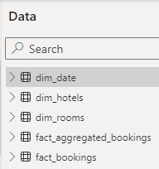
About Data:
AtliQ Hospitality Management Using Power BI
Data is provided in 5 Excel files named:
dim_date(date, mmm yy, day_type, week no)
dim_hotels(property_id, property_name, category, city)
dim_rooms(room_id, room_class)
fact_aggregated_bookings(property_id, check_in_date, room_category, successful_bookings, capacity)
And fact_bookings(booking_id, property_id, booking_date, check_in_date, checkout_date, no_guests, room_category, booking_platform, ratings_given, booking_status, revenue_generated, revenue_realized)
For the privacy reasons data can't be shared publically.
Dharmindar Ram Linkedin Portfolio Github E-mail

Slide 6
My Learning:
AtliQ Hospitality Management Using Power BI
Requirements understanding,
Power BI,
Data Modelling,
Dashoarding,
Insights generation,
Hospitality Domain Knowledge,
How project is executed in the industry
Dharmindar Ram Linkedin Portfolio Github E-mail

Slide 7
Approach Used:
AtliQ Hospitality Management Using Power BI
Requirements Understanding
Data Transformation
Calculating Key Performance Indicators(KPIs)
Building Dashboard
Dharmindar Ram Linkedin Portfolio Github E-mail

Slide 8
Requirements Understanding
AtliQ Hospitality Management Using Power BI
To build hospitality domain solution, needs to understand the business requirements and indicate which are important factors and business terms that can help in decision making and grow business.
Dharmindar Ram Linkedin Portfolio Github E-mail

Slide 9
1. Requirements Understanding
AtliQ Hospitality Management Using Power BI
Some of the important key performance indicators are:
Revenue
RevPAR(revenue per available room)
ADR(average daily rate)
DSRN(daily sellable room nights)
DBRN(daily booked room nights)
DURN(daily utilized room nights)
Occupancy %
Realisation %
Cancellation %
No show rate %
Booking % by platform
Booking % by room class
And WoW change % trends etc.
Dharmindar Ram Linkedin Portfolio Github E-mail

Slide 10
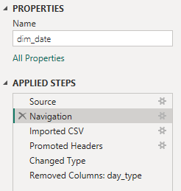
2. Data transformation
AtliQ Hospitality Management Using Power BI
Applied some data transformation on given data to make it more refined.
Dharmindar Ram Linkedin Portfolio Github E-mail

Slide 11

3. Calculating Key Performance Indicators(KPIs)
AtliQ Hospitality Management Using Power BI
These KPIs are calculated using DAX(Data Analysis Expression)
1. Revenue
2. Occupancy %
3. Cancellation %
Dharmindar Ram Linkedin Portfolio Github E-mail

Slide 12
3. Calculating Key Performance Indicators(KPIs)
AtliQ Hospitality Management Using Power BI
These KPIs are calculated using DAX(Data Analysis Expression)
4. No Show rate %
5. Booking % by Platform
6. Booking % by Room class
Dharmindar Ram Linkedin Portfolio Github E-mail

Slide 13

3. Calculating Key Performance Indicators(KPIs)
AtliQ Hospitality Management Using Power BI
These KPIs are calculated using DAX(Data Analysis Expression)
7. ADR
8. Realisation %
9. RevPAR
Dharmindar Ram Linkedin Portfolio Github E-mail

Slide 14


3. Calculating Key Performance Indicators(KPIs)
AtliQ Hospitality Management Using Power BI
These KPIs are calculated using DAX(Data Analysis Expression)
10. DBRN
11. DSRN
12. DURN
Dharmindar Ram Linkedin Portfolio Github E-mail

Slide 15
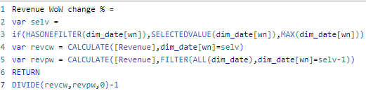
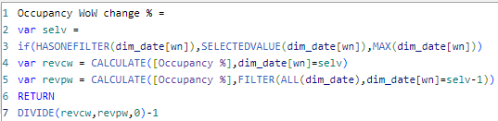
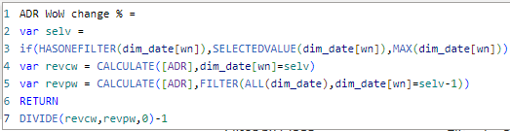
3. Calculating Key Performance Indicators(KPIs)
AtliQ Hospitality Management Using Power BI
Weekly changing % trends
13. Revenue WoW change %
14. Occupancy WoW change %
15. ADR WoW change %
Dharmindar Ram Linkedin Portfolio Github E-mail

Slide 16
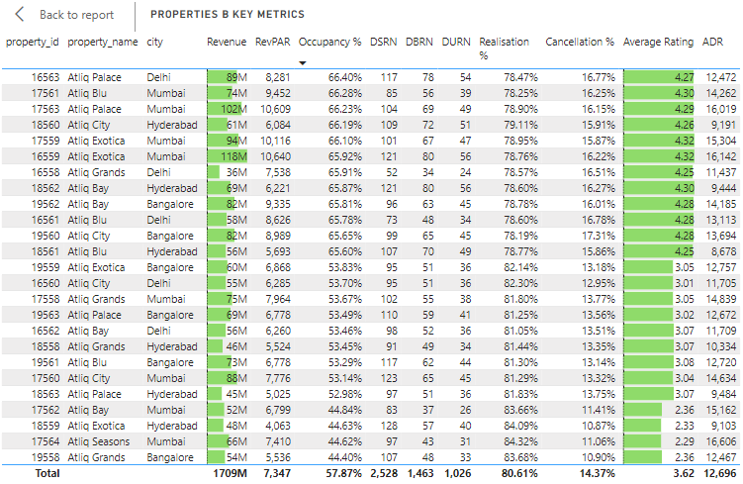
4. Building Dashboard
AtliQ Hospitality Management Using Power BI
Finally designed a cutting edge Power BI dashboard using different visualizations
This is table visualization, I’ve customized it and added all the key metrics.
Dharmindar Ram Linkedin Portfolio Github E-mail

Slide 17
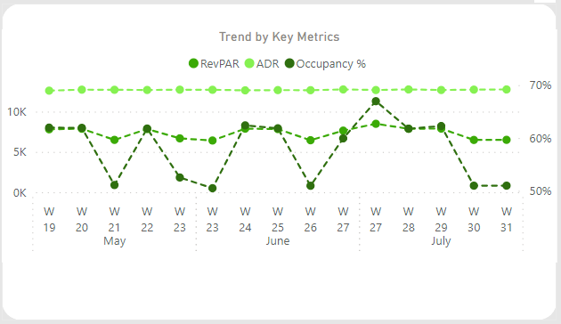
4. Building Dashboard
AtliQ Hospitality Management Using Power BI
This is a line chart showing ADR, RevPAR and Occupancy % trend over weeks
Dharmindar Ram Linkedin Portfolio Github E-mail

Slide 18
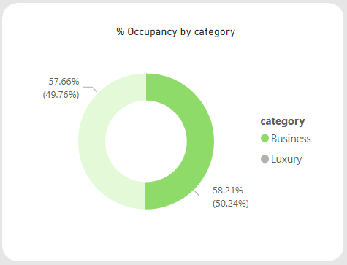
4. Building Dashboard
AtliQ Hospitality Management Using Power BI
This is a Donut Chart occupancy % by category i.e. Business and Luxury
Dharmindar Ram Linkedin Portfolio Github E-mail

Slide 19
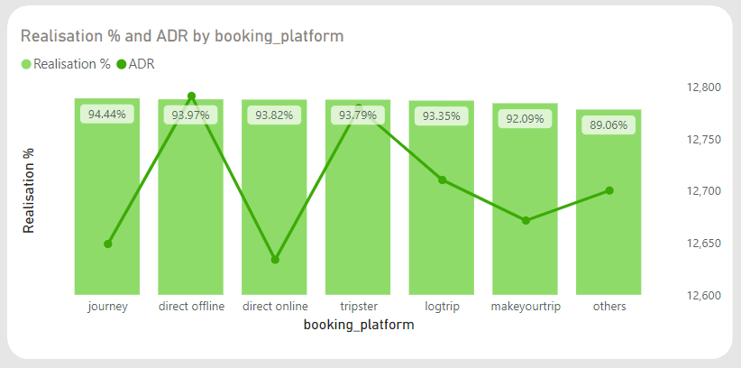
4. Building Dashboard
AtliQ Hospitality Management Using Power BI
This is Line and Stacked Column Chart showing realisation % and ADR by booking_platform.
Dharmindar Ram Linkedin Portfolio Github E-mail

Slide 20
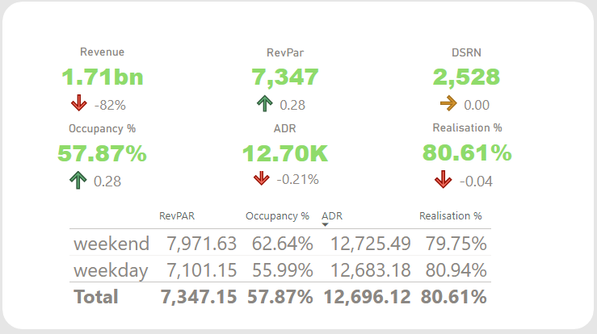
4. Building Dashboard
AtliQ Hospitality Management Using Power BI
This visual have multiple cards and a table below showing all the metrics.
Dharmindar Ram Linkedin Portfolio Github E-mail

Slide 21



4. Building Dashboard
AtliQ Hospitality Management Using Power BI
The visual shown below has three slicers for the purpose of different filters.
This visual contains a slicer for months. We’ve data of only 3 months.
The following slicer is used for week numbers.
Dharmindar Ram Linkedin Portfolio Github E-mail

Slide 22
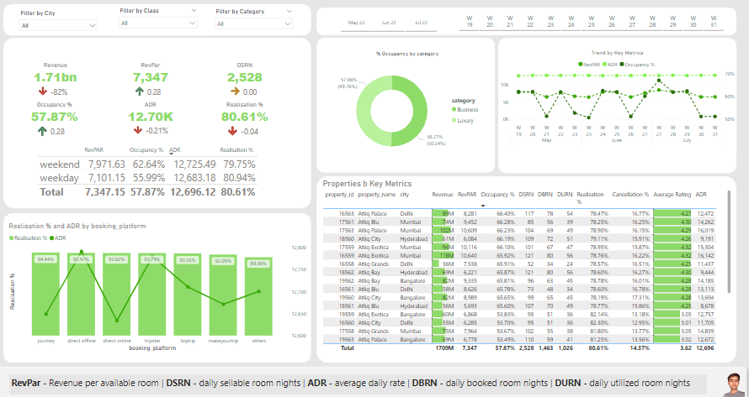
4. Building Dashboard
AtliQ Hospitality Management Using Power BI
Final dashboard.
Dharmindar Ram Linkedin Portfolio Github E-mail

Slide 23
Project Insights:
AtliQ Hospitality Management Using Power BI
Analysed total revenue
Calculated occupancy %, ADR % and RevPAR % change over weeks
Indicated top branches with respect to revenue
Explored occupancy % based on category
Dived into revenue by city, room class and room category
Segmented weekly and monthly revenue trends
Dharmindar Ram Linkedin Portfolio Github E-mail

Slide 24
Project Findings:
AtliQ Hospitality Management Using Power BI
This project covered all the necessary key factors of the business and unveiled revenue trends by every aspect. Shown % change of key metrics over specific time period, this helps in decision making.
Dharmindar Ram Linkedin Portfolio Github E-mail

Slide 25

DHARMINDAR RAM
Data Enthusiast | ML Engineer | Data Analyst
Linkedin Portfolio Github E-mail

